Slide 1
Collada/FBX to binary structure
File structure
V1.0
G. Dumitra

Slide 2
History
version | changes
1.0 | Define structures
1.1
1.2

Slide 3
Summary
How to export from Blender to Collada
Known limitations of Blender
Example of exporting settings
Internal file structure
MTL structure
Known limitations: MTL structure
OBJ structure

Slide 4
How to export from Blender to OBJ: Known limitations of Blender
The implementation is using the “COLLADA – Digital Asset Schema Release 1.5.0”
At this date [2021-10-06] the following limitations are noticed into this converted implementation
As the OBJ format has too many limitation I decided to abandon the OBJ converter to a mobile-friendly binary data format and start all work over again into a more powerful format.
I decided to Collada because it is an open format and it is supported officially by the Khronos Group too.
Note
Each game spirit/graphical object (i.e. building, tree, etc) is represented by a unique Collada file name.
This means:
You serialize each Collada file per-game-spirit.
Limitations
There is (at this moment) no support for:
Armatures
Animation
Lights
Cameras
Empty objects

Slide 5
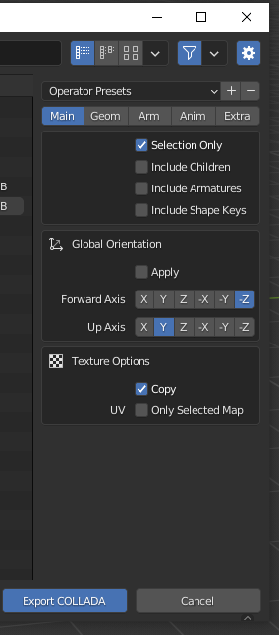
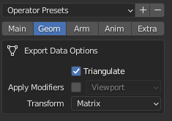
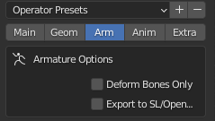
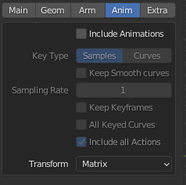
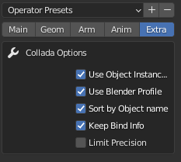
How to export from Blender to Collada DAE: Example of exporting settings
Make sure there is no camera nor light selected. At this moment they are not supported!
If you export for OpenGL use this example. For Vulkan you need to set the “Up Axis” to –Y
Use “Triangulate” to export faces as triangles.
Not (yet) supported features
Optional stuff..not important for the exporter I think (to be tested)

Slide 6
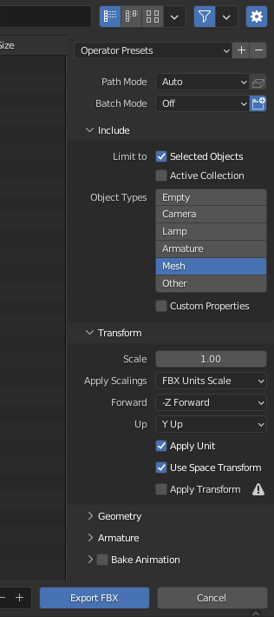
How to export from Blender to FBX : Example of exporting settings
Make sure there is no camera nor light selected. At this moment they are not supported!
If you export for OpenGL use this example. For Vulkan you need to set the “Up Axis” to –Y
FBX Units Scale is a MUST!
Not (yet) supported features

Slide 7
Internal file structure: the file is showing the content of a single graphical object (i.e. a tree, a house, etc.)
Material(s) information: Array of Material(s)
n
Array of materials
Array of object´scomponents:
Array of components
MTL material ID (or -1 in case of none) <signed short>
n
Array of components
Component
1
t
Mesh
My Object

Slide 8
Array of materials: data structure
No of materials <signed int>
1
Material name
<array of signed chars>
No of chars <short>
“is ambient color ?” Bool 0 or 1 <byte>
R,G,B,A color
Array of float [4]
One material unit
“is diffuse color ?” Bool 0 or 1 <byte>
R,G,B,A color
Array of float [4]
ambient TEXTURE file name
<array of signed chars>
No of chars <short>
diffuse TEXTURE file name
<array of signed chars>
No of chars <short>
m

Slide 9
Array of Collada objects: the structure as binary and the way they are used (as example, with black color) into a game.
The components are from 1..n while inside of each components there are between 1..t meshes.
<used by>
GameObject
* <No of Components>
No of Components <signed int>
1
Component name
<array of signed chars>
No of chars <signed short>
GameObjectComponent
* <No of Meshes>
No of subcomponents / meshes <signed int>
<used by>
1
Material ID <signed short>
GameCavanMesh
Material ID
Array of vertices
Array of indices … etc..
No of vertices <signed int>
<used by>
“is U,V ?” Bool 0 or 1 <byte>
“is Normal?” Bool 0 or 1 <byte>
“is Color per vertex?” Bool 0 or 1 <byte>
One vertex
unit (VBO unit)
1
X,Y,Z coordinates
Array of float [3]
Only if “U,V” value=1 →
U,V coordinates(*)
Array of float [2]
Only if “is Normal” value=1 →
One mesh
unit
X,Y,Z normal
Array of float [3]
Only if “color per vertex” value=1 →
R,G,B,A color
Array of float [4]
v
No of indices (*) <signed int>
indexID / VAO element
Array of <signed int>
t
n
(*) <No of indices> == <No of vertices> . This value is not needed but kept as I may update the engine for other forms later.

Slide 10
Appendix

Slide 11
Internal file structure
MTL Information Array of Material(s)
n
Array of materials
Array of Face(s) (triangles)
MTL material ID (or -1 in case of none) <signed short>
n
Array of vertices

Slide 12
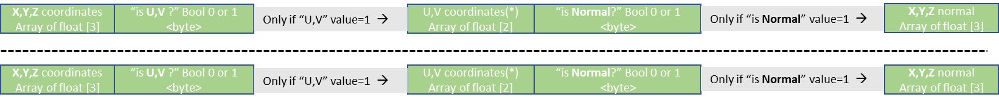
Internal file structure: more details
MTL Information Array of Material(s)
No of materials <signed int>
Array of materials
Material name
<array of signed chars>
No of chars <short>
“is KA ?” Bool 0 or 1 <byte>
X,Y,Z coordinates
Array of float [3]
See next page for full details
Array of Face(s) (triangles)
MTL ID
1..n
Items no.
Array of vertices
MTL ID
1..n
Items no.

Slide 13
Array of materials: MTL structure
No of materials <signed int>
0
Material name
<array of signed chars>
No of chars <short>
“is KA ?” Bool 0 or 1 <byte>
X,Y,Z coordinates
Array of float [3]
“is KD ?” Bool 0 or 1 <byte>
X,Y,Z coordinates
Array of float [3]
“is KS ?” Bool 0 or 1 <byte>
X,Y,Z coordinates
Array of float [3]
“is KE ?” Bool 0 or 1 <byte>
X,Y,Z coordinates
Array of float [3]
One material unit
Ns <float>; “-1” => not available
Ni <float>; “-1” => not available
d <float>; “-1” => not available
illum <byte>; “-1” => not available
Map_ka file name
<array of signed chars>
No of chars <short>
Map_kd file name
<array of signed chars>
No of chars <short>
Map_ks file name
<array of signed chars>
No of chars <short>
Map_ke file name
<array of signed chars>
No of chars <short>
Map_ns file name
<array of signed chars>
No of chars <short>
Map_d file name
<array of signed chars>
No of chars <short>
n
Map_Bump file name
<array of signed chars>
No of chars <short>
bm <float>

Slide 14
Array of OBJ/faces: OBJ structure
No of OBJs <signed int>
0
Obj name
<array of signed chars>
No of chars <signed short>
MTL material ID (or -1 in case of none) <signed short>
No of triangles/faces units <signed int>
X,Y,Z coordinates
Array of float [3]
“is U,V ?” Bool 0 or 1 <byte>
Only if “U,V” value=1 →
U,V coordinates(*)
Array of float [2]
“is Normal?” Bool 0 or 1 <byte>
Only if “is Normal” value=1 →
X,Y,Z normal
Array of float [3]
One vertex unit
“is Color per vertex?” Bool 0 or 1 <byte>
R,G,B,A color
Array of float [4]
0

Slide 15
Parametes and known limitations:
MTL parser
Ka = “ambient reflectivity” (material ambient is multiplied by the texture value)
Only “Ka r g b” is supported. Same for “Kd” and “Ks”
Not supporting “Ka spectral file.rfl factor”
Not supporting “Ka xyz x y z”
map_Ka (!! see “2. MTL structure” for limitations !!)
Specifies that a color texture file or a color procedural texture file is applied to the ambient reflectivity of the material. During rendering, the "map_Ka" value is multiplied by the "Ka" value.
Ks = “specular reflectivity”
map_Ks (!! see “2. MTL structure” for limitations !!)
specular reflectivity of the material (value is multiplied by the "Ks" value)
Kd = “diffuse reflectivity”
map_Kd (!! see “2. MTL structure” for limitations !!)
diffuse reflectivity of the material (value is multiplied by the "Kd" value)
Ke= “emissive coeficient”
It goes together with ambient, diffuse and specular and represents the amount of light emitted by the material. If you also have a defined emission color the material will irradiate light.
map_Ke (!! see “2. MTL structure” for limitations !!)
diffuse reflectivity of the material (value is multiplied by the "Ke" value)
map_Bump = Specifies that a bump texture file is linked to the material. To be see how this is working against the normal.
Supported parameters: only bm = float [0.0…1.0]

Slide 16
Parametes and known limitations:
MTL parser (continue)
Illum = “specifies the illumination model to use in the material” (hint: search for “The illumination models are:” http://paulbourke.net/dataformats/mtl/)
0 Color on and Ambient off
1 Color on and Ambient on
2 Highlight on
3 Reflection on and Ray trace on
4 Transparency: Glass on; Reflection: Ray trace on
5 Reflection: Fresnel on and Ray trace on
6 Transparency: Refraction on; Reflection: Fresnel off and Ray trace on
7 Transparency: Refraction on; Reflection: Fresnel on and Ray trace on
8 Reflection on and Ray trace off
9 Transparency: Glass on; Reflection: Ray trace off
10 Casts shadows onto invisible surfaces
d factor = “the amount this material dissolves into the background. A factor of 1.0 is fully opaque. This is the default when a new material is created. A factor of 0.0 is fully dissolved (completely transparent).”
Sharpness = not supported
Ns = specular exponent for the current material. Values = 0..1000
Ni = Specifies the optical density for the surface. Values = 0.001..10 (usually values are >1.0)
Note:
- Ka - material ambient is multiplied by the texture value
- Kd - material diffuse is multiplied by the texture value
- Ks - material specular is multiplied by the texture value

Slide 17
Known limitations:
2. MTL structure: map_ka, map_kd are supported without “options”: Examples:
OK => “map_Ka mapfile.png”
NOK => “map_Ka -s 1 1 1 -o 0 0 0 -mm 0 1 chrome.mpc” (program will crash!)
Options that are not supported (according to http://paulbourke.net/dataformats/mtl/ )
-blendu on | off
-blendv on | off
-cc on | off
-clamp on | off
-mm base gain
-o u v w
-s u v w
-t u v w
-texres value
3. All strings are US-ASCII

Slide 18
Example
Take as an example the already serialized file “/examples/cube_output.bin”

Slide 19
Structure Example:
According to the definition of the file structure from page 5, we are looking first for the number of materials used by the object.
The file starts as:
No of materials <signed int>
This means we have 2 materials we shall load into memory.

Slide 20
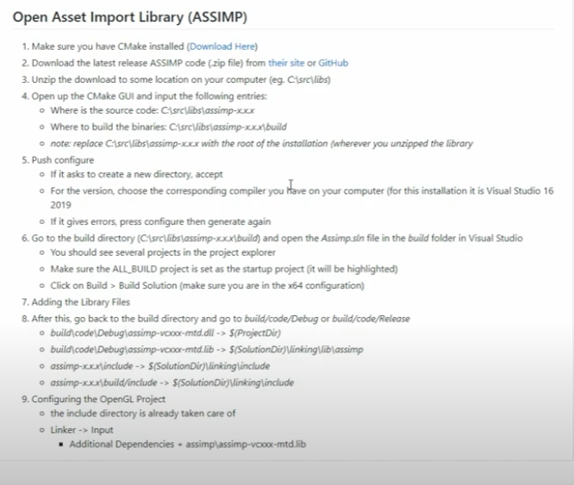
appendix
Build Assimp from here: https://youtu.be/oci7xJEg6sU?si=52p716mh9MqGzqr2&t=30

